Slide 1
Tangshan, China 1976 Earthquake
Science 2

Slide 2
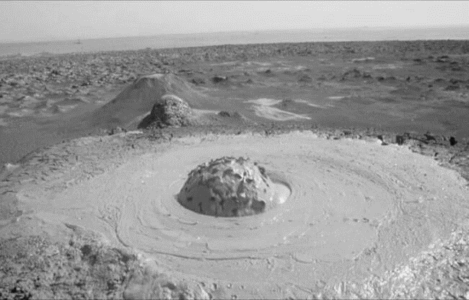
Effects of the Disaster - X Area
370-km^2 X Intensity – leveled 80% of all dwellings [1]
Half of the industrial buildings in this area were destroyed [1]
The earthquake created fountains and mud volcanoes [1]
Irrigation wells failed [1]
Figure 1

Slide 3
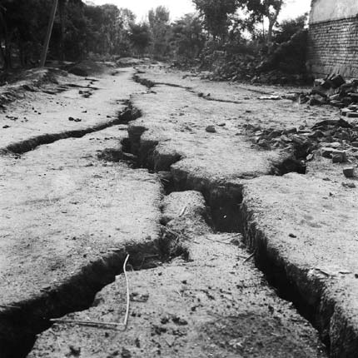
Effects of the Disaster - IX Area
1800-km^2 IX Intensity – destroyed 40% of all dwellings [1]
Half of the industrial buildings in this area were destroyed [1]
Up to 3 diameter mud volcanoes sprayed sand on farm land[1]
Sagging and fissuring of the ground surface [1]
Figure 2

Slide 4
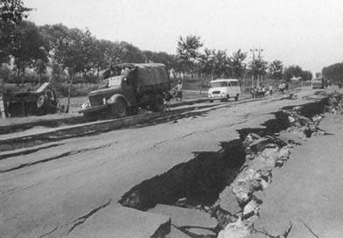
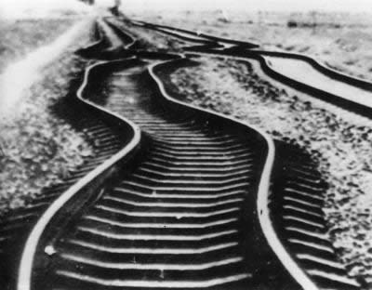
Effects of the Disaster
Transportation infrastructure destroyed [2]
Roads destroyed
Bridges collapsed
Railroad lines bent
Figure 3
Figure 4

Slide 5
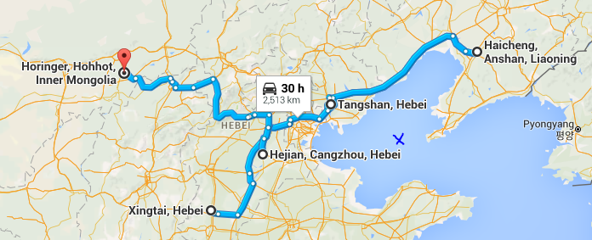
Previous Events in the Region
1966 Xingtai earthquake
1967 Hejian earthquake
1969 Bohai earthquake
1975 Haicheng earthquake
1976 Horinger earthquake
Bohai Sea
Figure 5

Slide 6
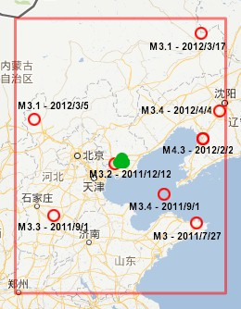
Outlook for Future Events
2012 Tangshan Earthquake 4.8 [3]
2015 Inner Mogila Earthquake – 5.8
Asia has one of the highest levels of seismicity on the planet [4]
As of 2009, China has 2574 earthquake monitoring stations to help measure and predict seismic activity [4]
Figure 6

Slide 7
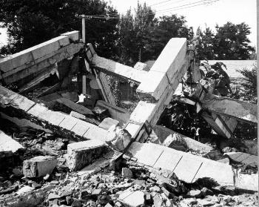
Significant Factors
Poor ground condition (sandy or puddly soil) contributed to the hardest hit regions [1]
In Tianjin, alluvial deposits and the high water table contributed to severity of the destruction. [1]
Poor construction quality [1]
Earlier earthquake threw off scientists predictions [1]
Figure 6

Slide 8
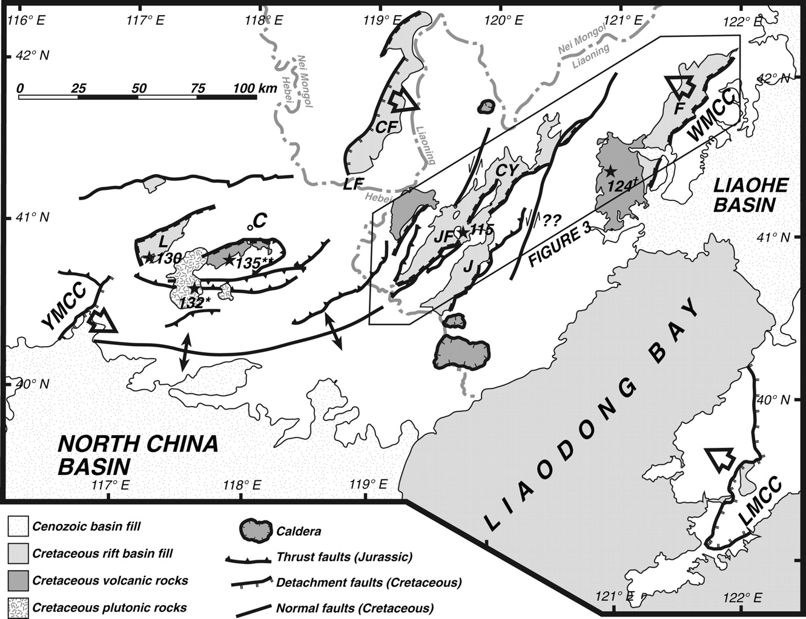
Interesting Details
Yan Shan belt anomalies
Less frequent small earthquakes [1]
Regular distribution of the first motion [1]
Formation of seismic gap [1]
P and S wave velocity ration getting closer to 1 [1]
Decrease in b-value [1]
Southern piedmont raised between 1970 – 1975
Figure 7

Slide 9
Interesting Details
Odd things happened before the earthquake
Well water rose and fell 3 times the day before quake. [1]
Gas spouted out of a well weeks before the earthquake [1]
Animals acted strange before the strike [1]
Goldfish repeatedly jumped out of bowl
Chickens wouldn’t eat
Mice and weasels ran about looking for hiding places
Lights and Fireballs in the sky [1]
Roaring noises louder than an airplane [1]

Slide 10
Bibliography
[1] Wang ,F., (unknown) . The 1976 Tangshan Earthquake. Retrieved from https://app.box.com/embed/preview/ryxink1a4rxj437pq0ngxefo4388bf82?theme=dark
[2] Rosenburg, J., (unkown) . Tangshan: The Deadliest Earthquake. Retrieved from https://app.box.com/embed/preview/ryxink1a4rxj437pq0ngxefo4388bf82?theme=dark
[3] Vervaeck, A. (May 31, 2012). Moderate earthquake near Tangshan, China reminds the 1976 disaster (also felt in Beijing today) Retrieved from http://earthquake-report.com/2012/05/28/moderate-earthquake-near-tangshan-china-reminds-the-1976-disaster-also-felt-in-beijing-today/
[4] International Workshop on Earthquake Risk Reduction in Northeast Asia Region, (April 2010) . REDUCTION OF EARTHQUAKE LOSSES IN THE NORTHEAST ASIA REGION – RELNAR - Retrieved from http://www.preventionweb.net/files/13898_187891e1.pdf
Figure 1 - http://en.citizendaily.net/wp-content/uploads/2015/07/mud-volcano-azerbaijan-4.jpg Figure 2 - http://www.chinadaily.com.cn/china/2006-07/26/xin_2707032610054542336414.jpg
Figure 3 - http://lishi.huisongshu.com/img/uploak/7/11937.jpg
Figure 4 -http://www.chinadaily.com.cn/china/images/attachement/jpg/site1/20080616/0013729e4abe09c04af203.jpg
Figure 5-https://www.google.com/maps/dir/Xingtai,+Hebei,+China/Tangshan,+Hebei,+China/Haicheng,+Anshan,+Liaoning,+China/Hejian,+Cangzhou,+Hebei,+China/Horinger,+Hohhot,+Inner+Mongolia,+China/
Figure 6 – http://earthquake-report.com/wp-content/uploads/2012/05/cn-28052012-2.jpg
Figure 7 - http://earthquake.usgs.gov/earthquakes/world/events/images/1976_07_27_545.jpg
Figure 8 - http://sp.lyellcollection.org/content/280/1/201/F2.large.jpg

